Slide 1
Life Beyond Pandas: Workflows with DuckDB, Daft, Polars, and Datafusion

Slide 2
Mimoune Djouallah (mim)
Member of Microsoft Fabric CAT team since Dec 2023
PowerBI user . ( Ex Construction Planner, Oil & Gas and renewable)
https://datamonkeysite.com/ (blogs about data tools in general )
Twitter @mim_djo
LinkedIn : https://www.linkedin.com/in/mimounedjouallah/

Slide 3
Evolution of the Data Warehouse
1990s–2000s Early Data Warehouses - Storage tightly coupled with compute
2010s Cloud Data Warehouses - Storage and compute separated
2017–2023 Open Table Formats (Engine-Tied) - Table formats decoupled from compute but JVM-based - Hive Tables, Hudi, Iceberg , Delta Lake - Spark as primary engine
2023–Present Native Lakehouse - Non-Java Readers and writers - Any engine: Trino, DuckDB, Spark, Flink, Snowflake, Fabric DWH , PostgreSQL

Slide 4






Lakehouse architecture give you options
Data
Factory
Analytics
Databases
Real-Time Intelligence
Power BI
OneLake

Slide 5
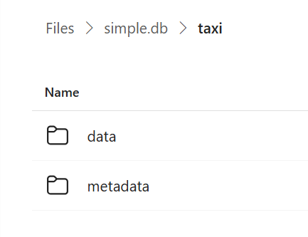
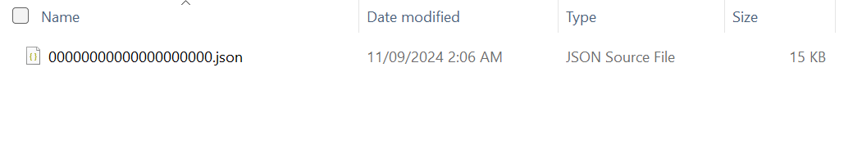
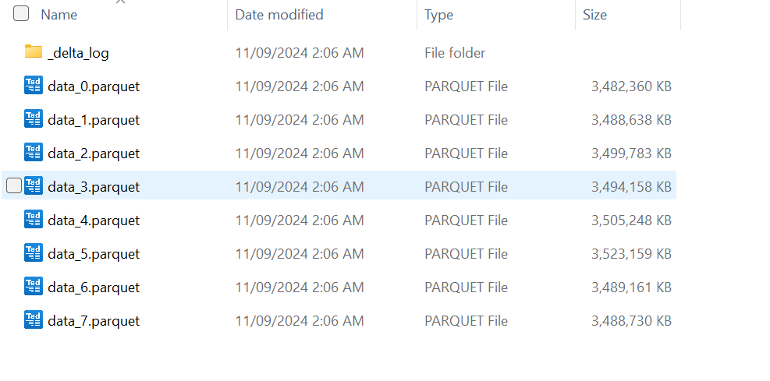
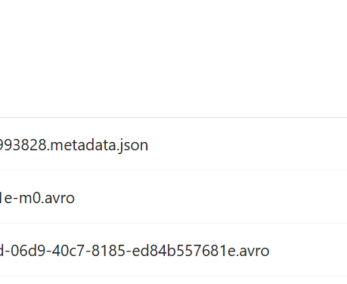
Open Table Format (Delta & Iceberg)

Slide 6
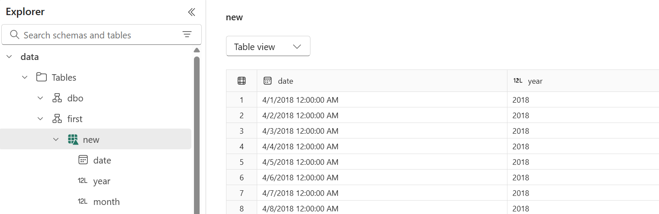
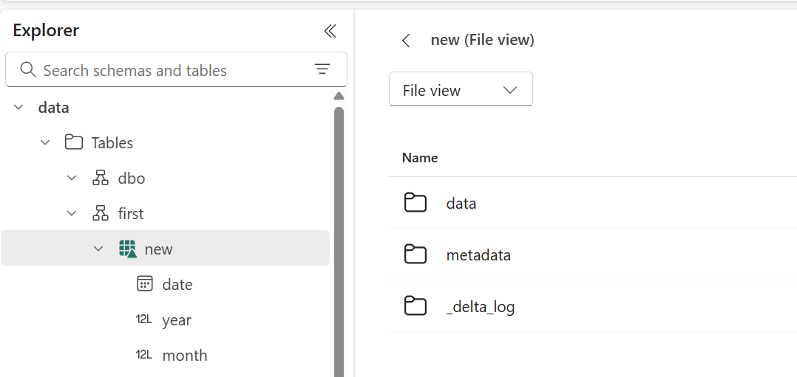

Slide 7
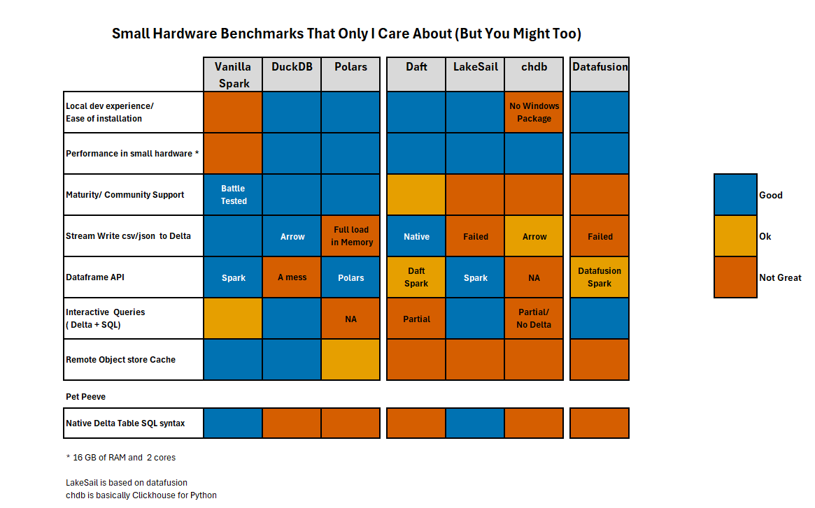

Slide 8
Pandas

Slide 9
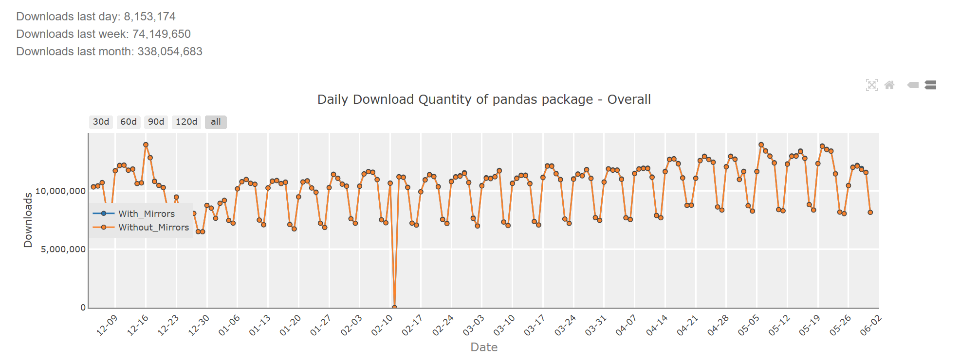
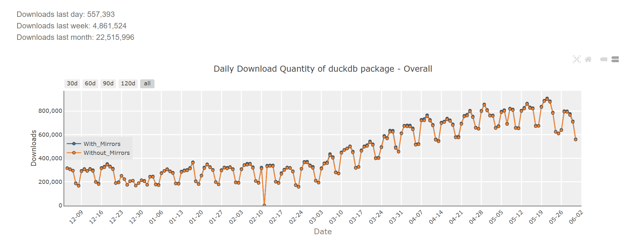

Slide 10
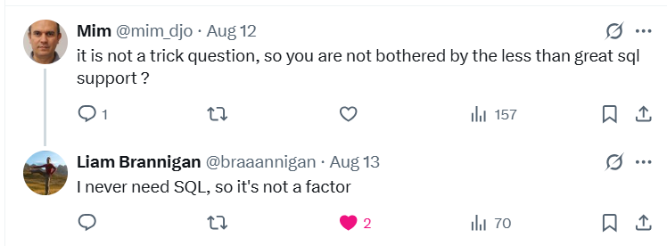

Slide 11
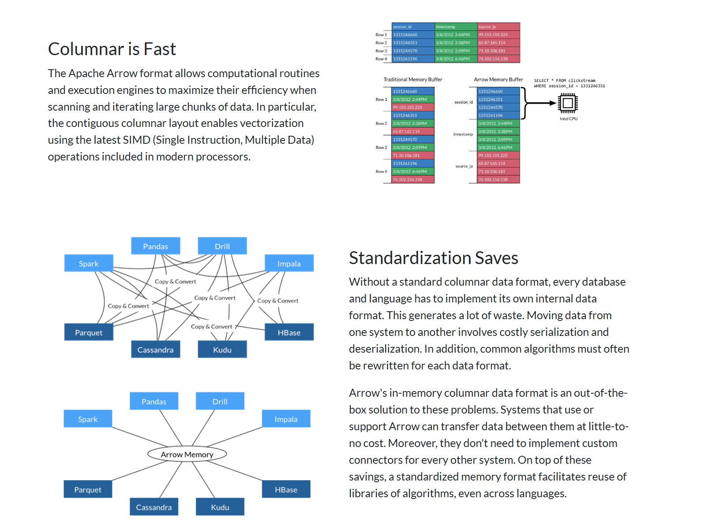

Slide 12
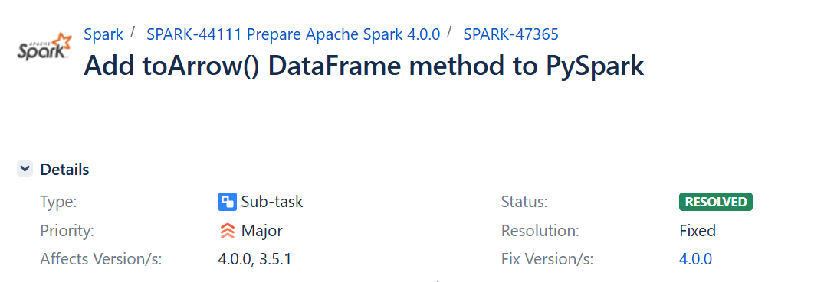
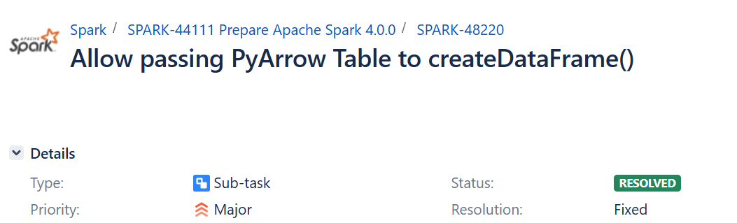

Slide 13
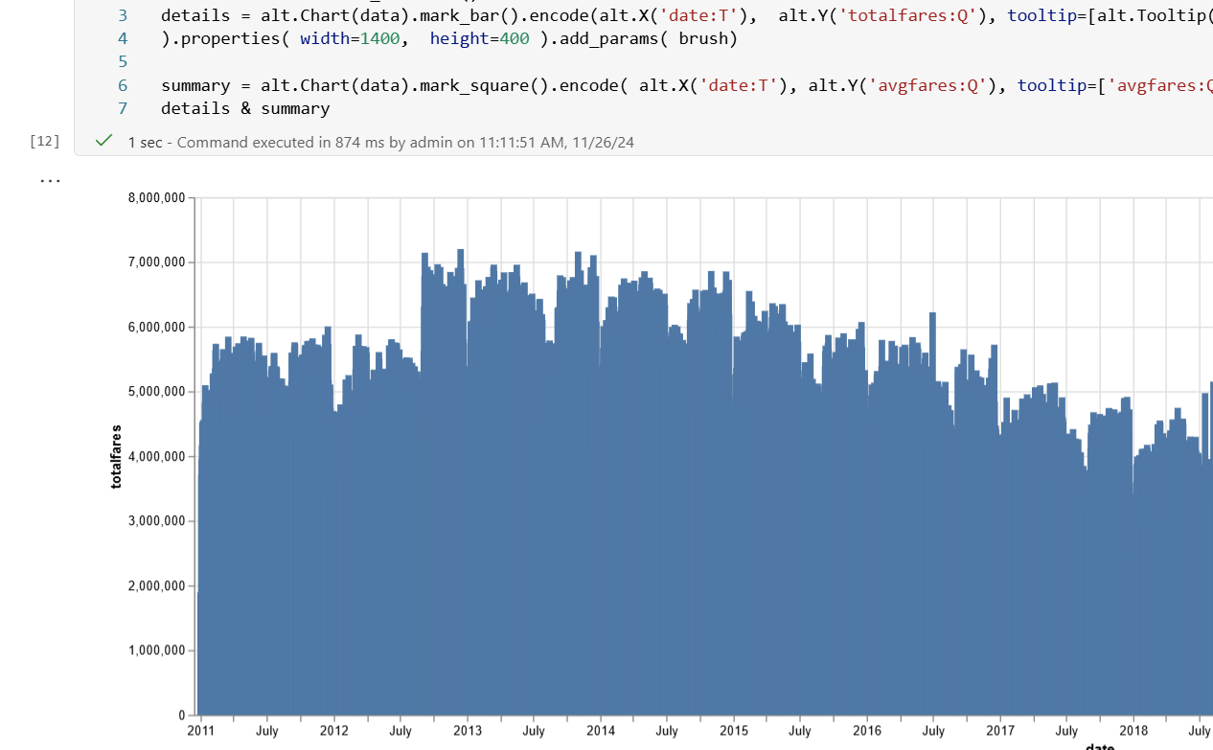
Analytical Queries

Slide 14
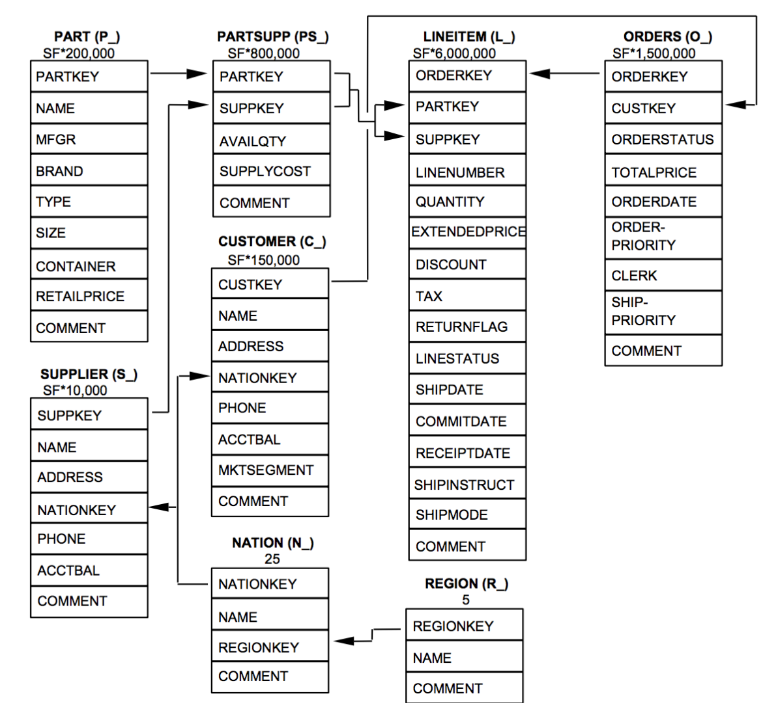

Slide 15
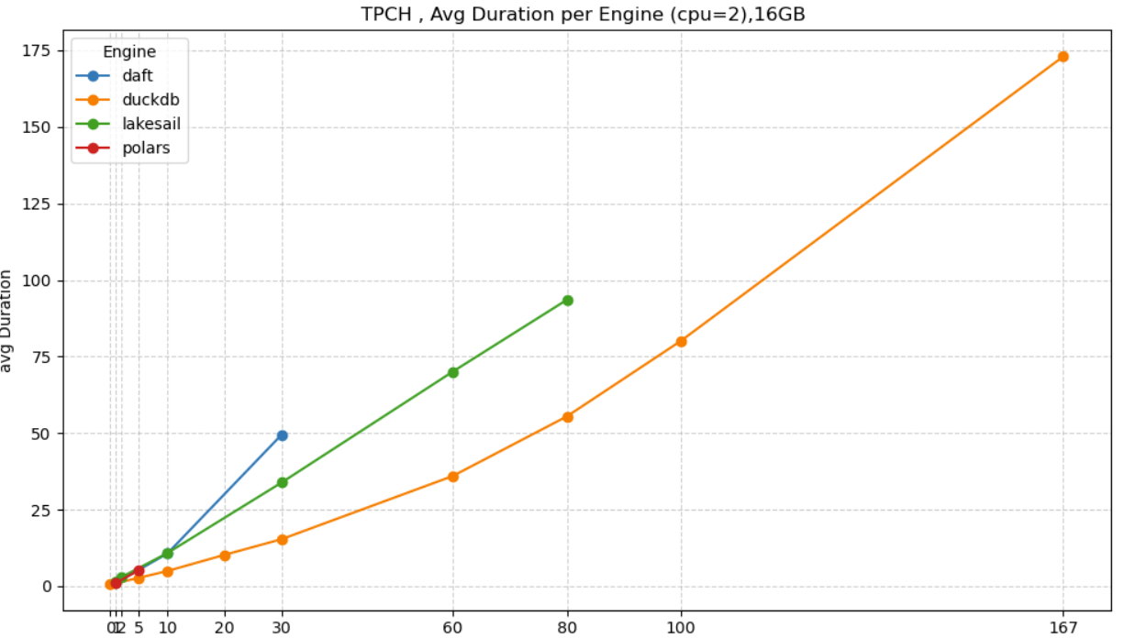

Slide 16
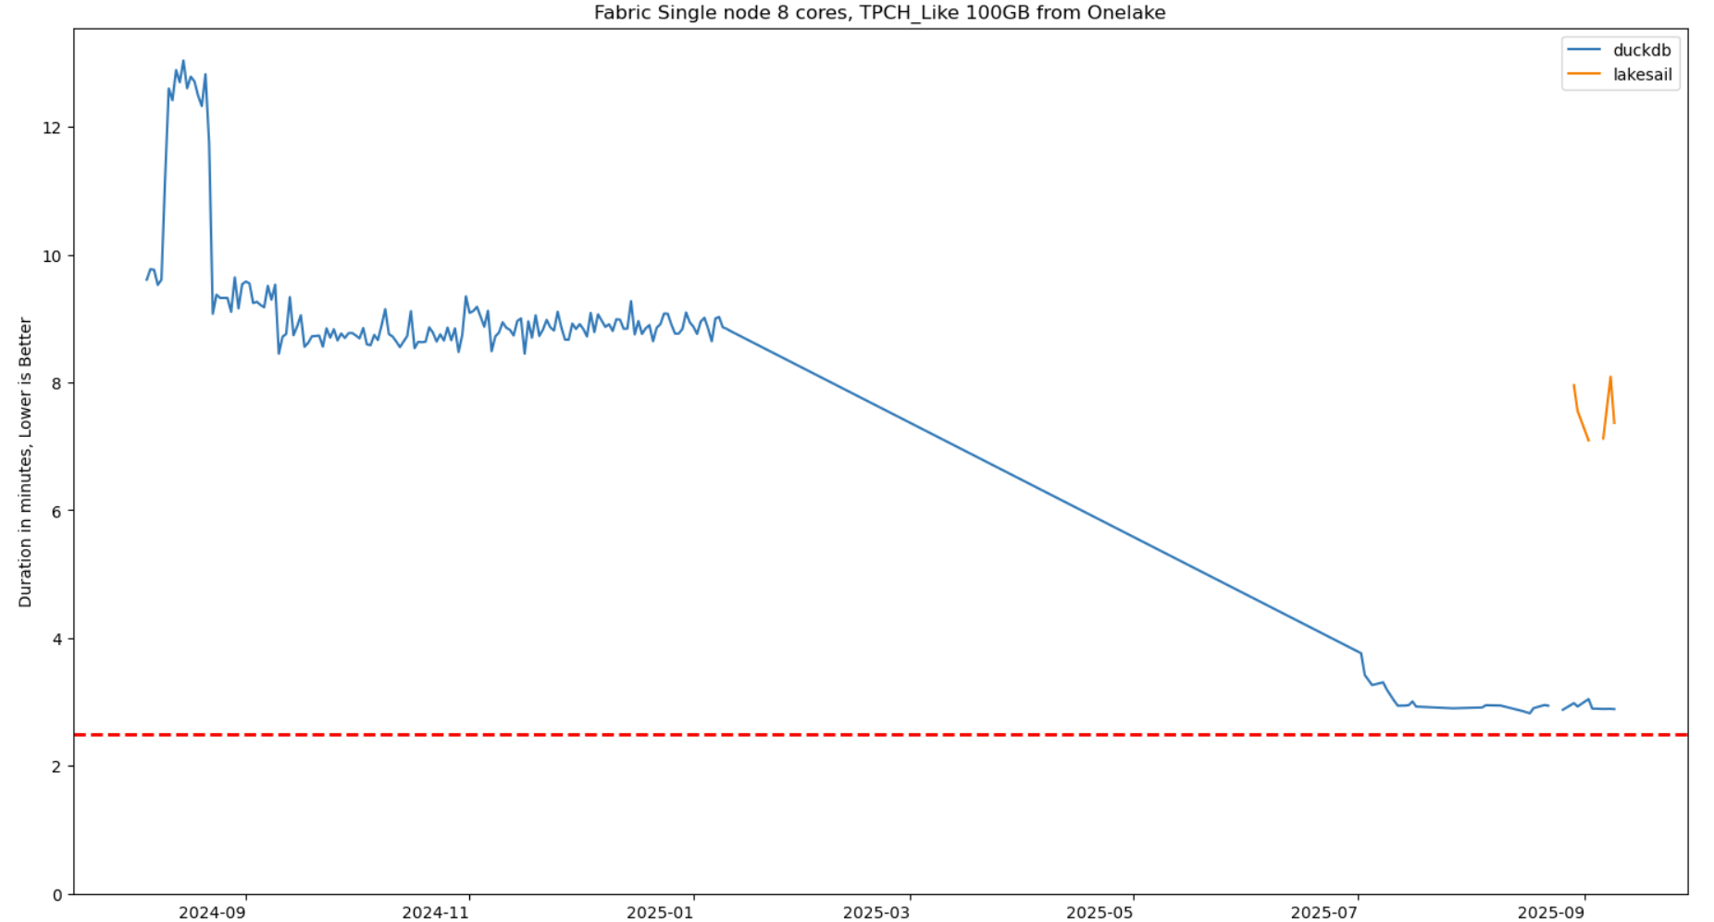

Slide 17
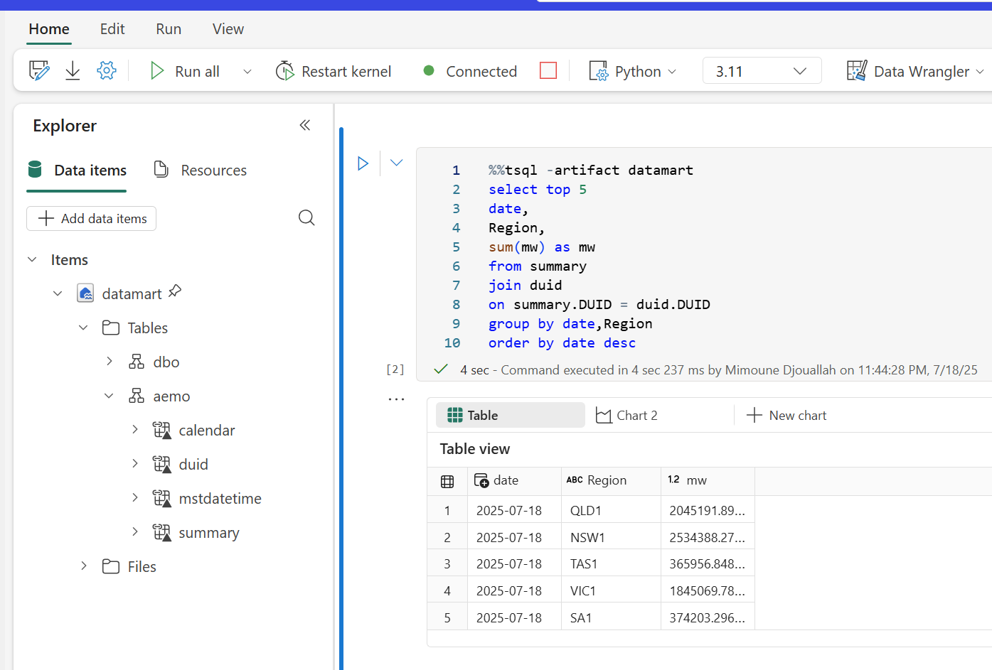

Slide 18
What is small data
Data fit in Memory ☺ ☺ ☺
Spill to disk ☺ not too slow but limited to disk size
Spill to Remote Storage ( S3, Onelake etc) ☺ virtually unlimited but slow
Still Python engine will trigger OOM sometimes

Slide 19
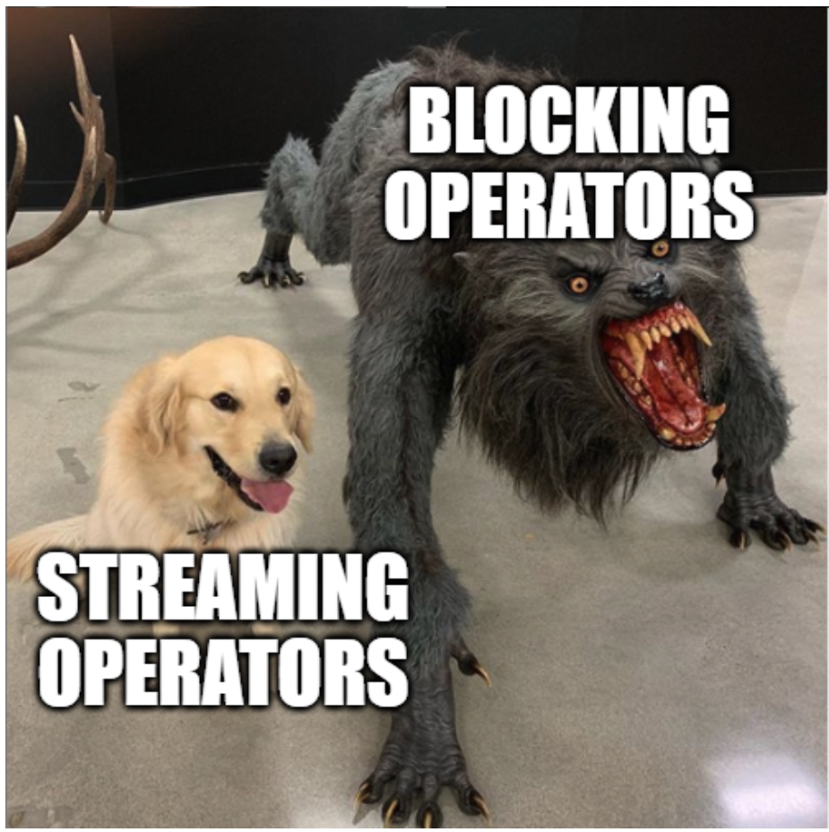
Transformation complexity

Slide 20
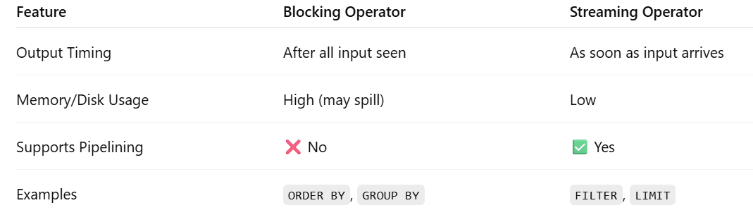

Slide 21
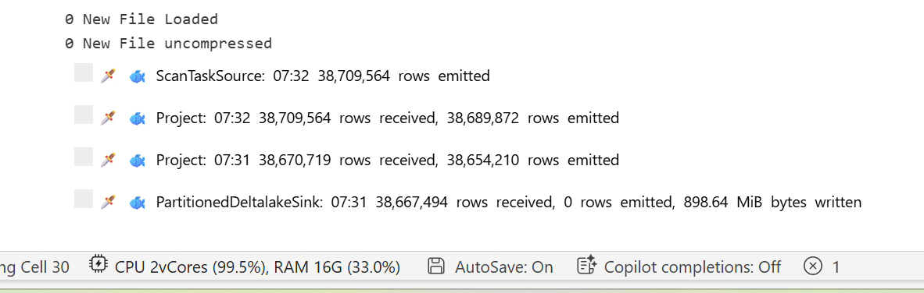

Slide 22
Data Transformations

Slide 23
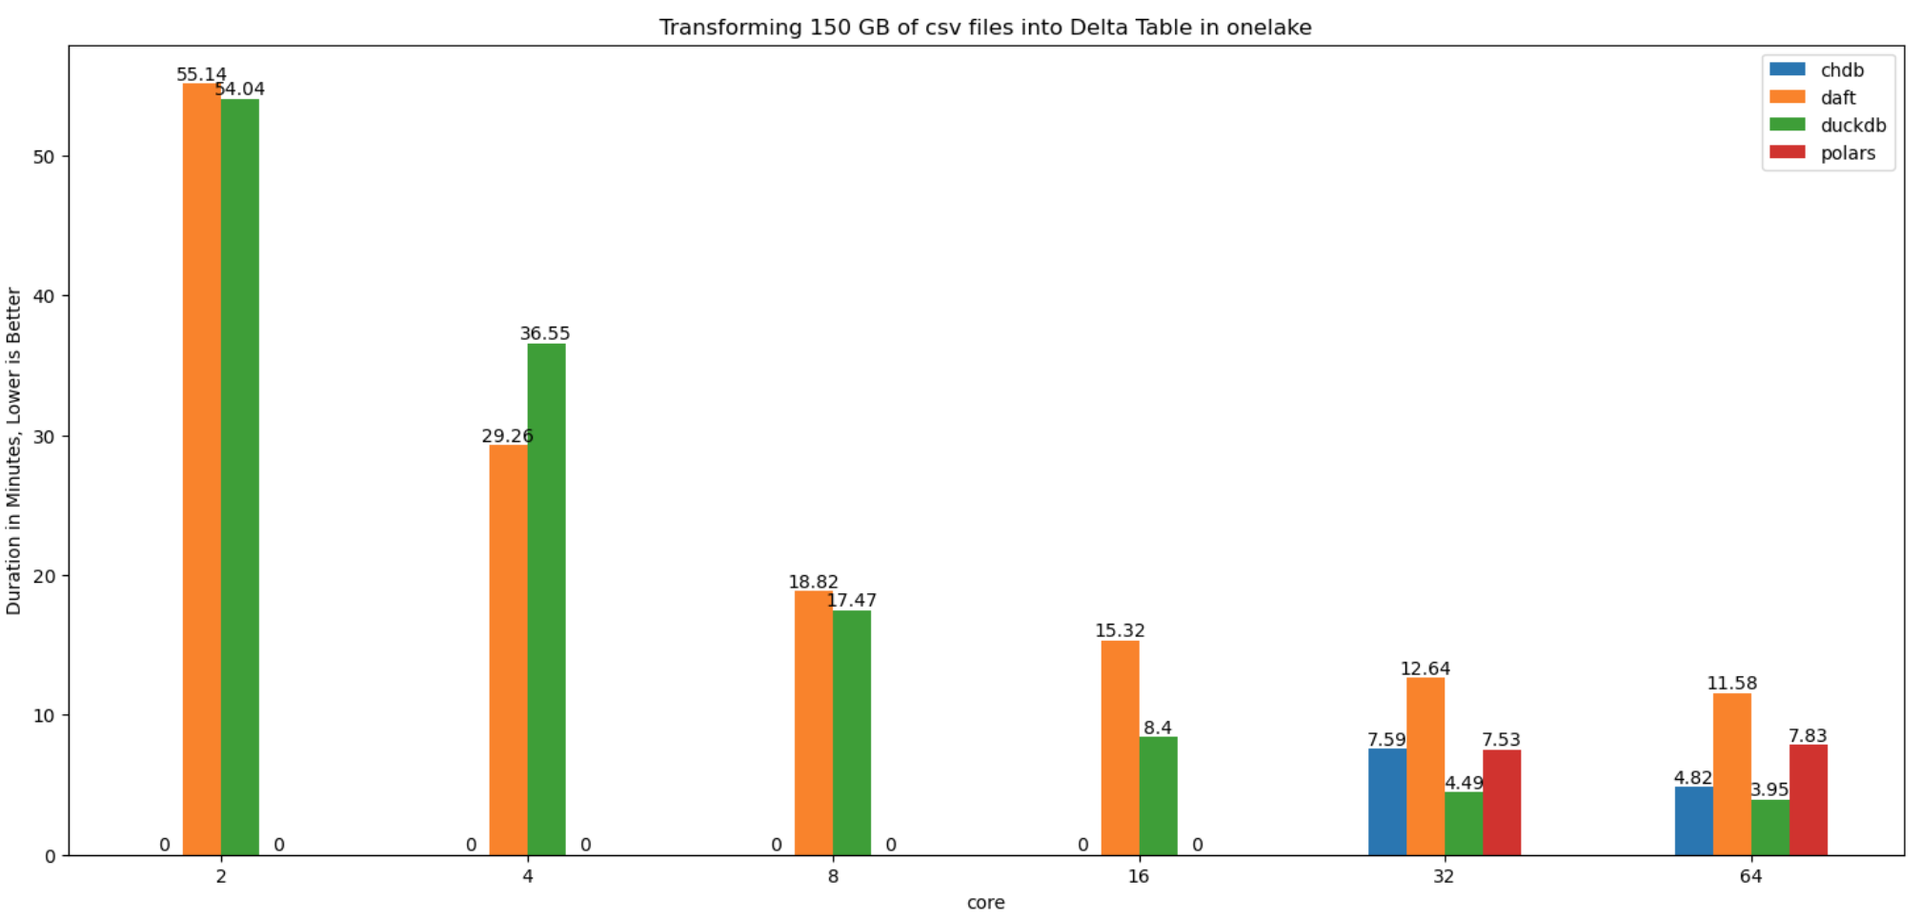

Slide 24
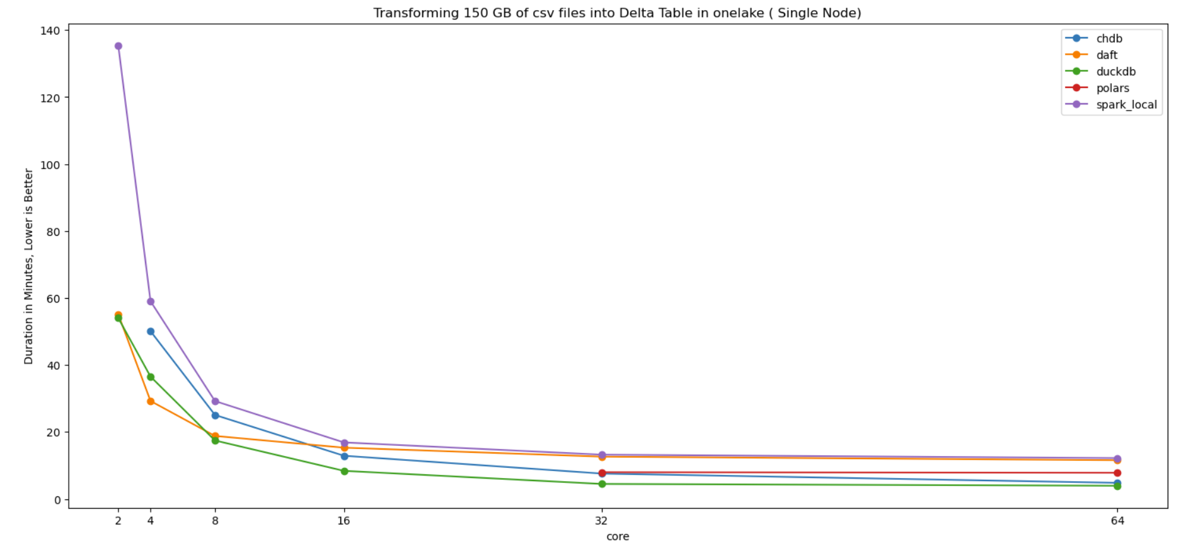

Slide 25
No Standard Dataframe API

Slide 26
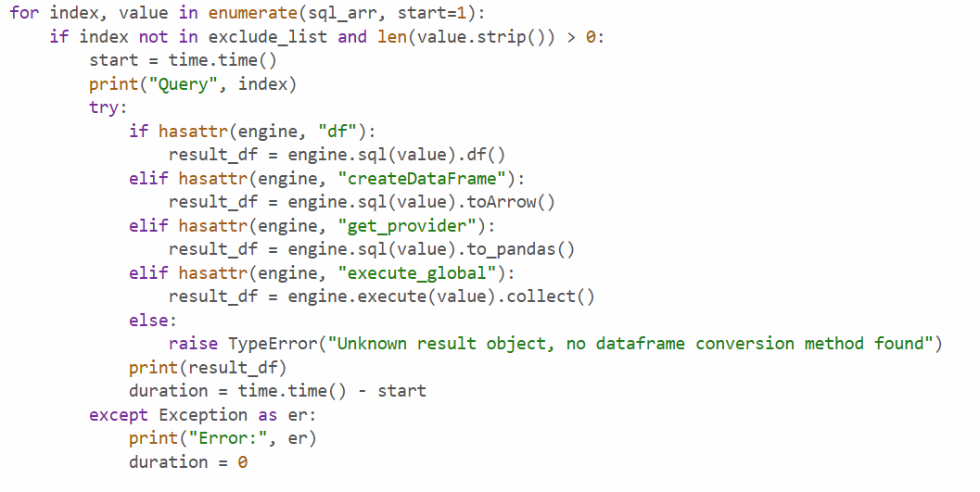

Slide 27
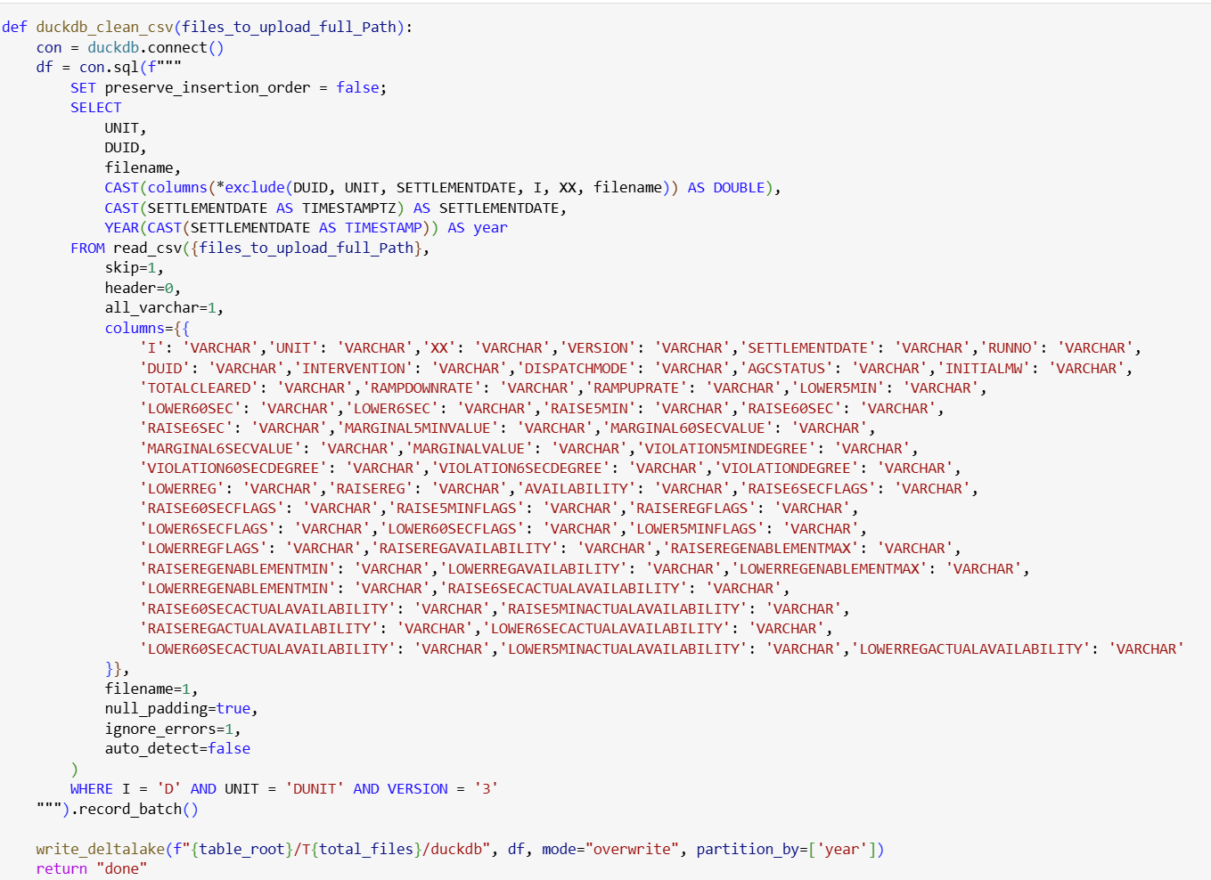

Slide 28
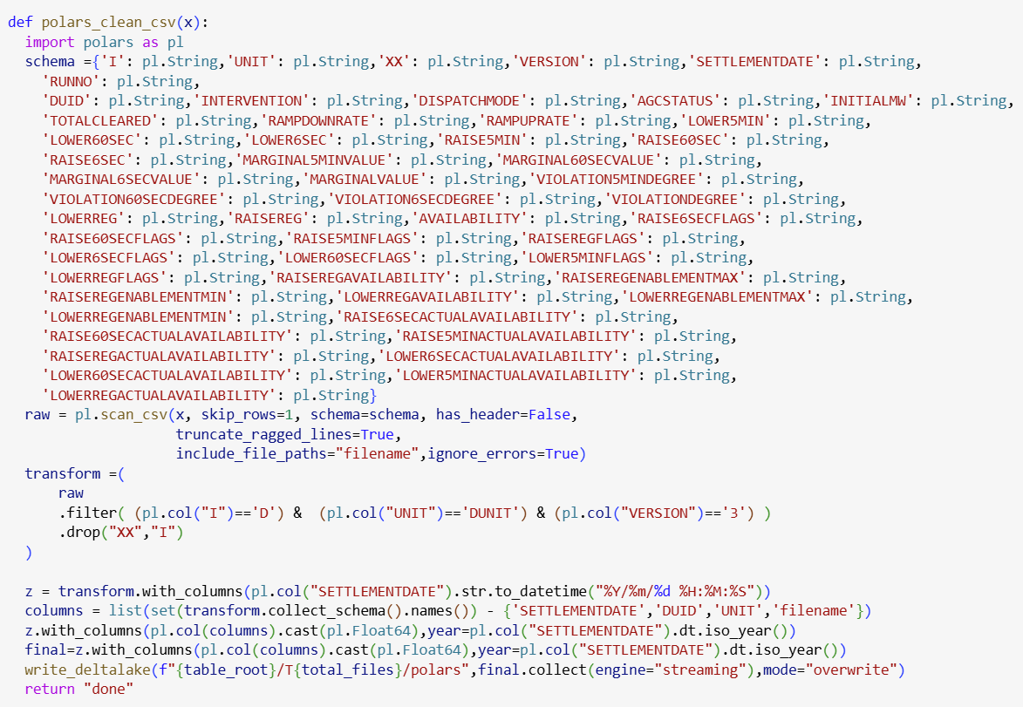

Slide 29
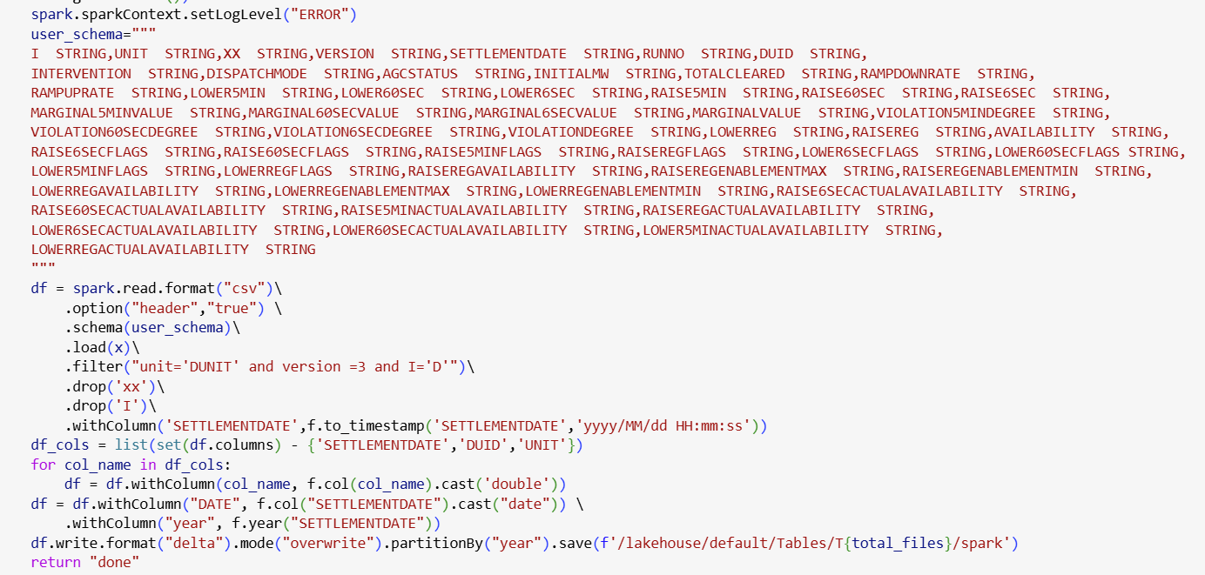

Slide 30
Maybe there is Hope

Slide 31
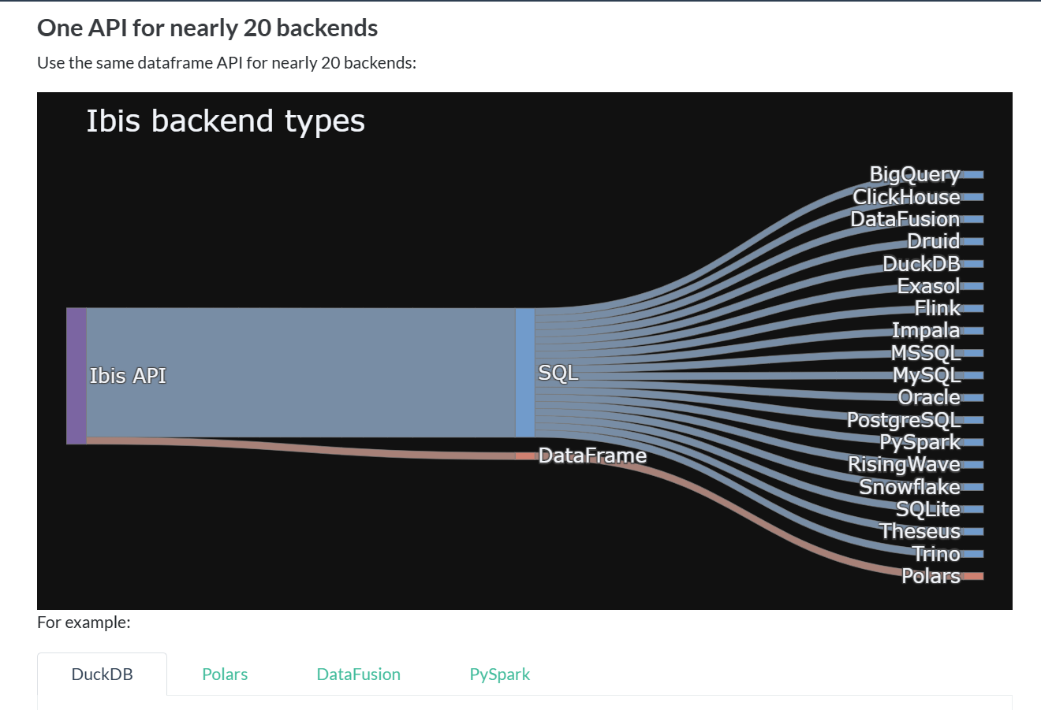

Slide 32
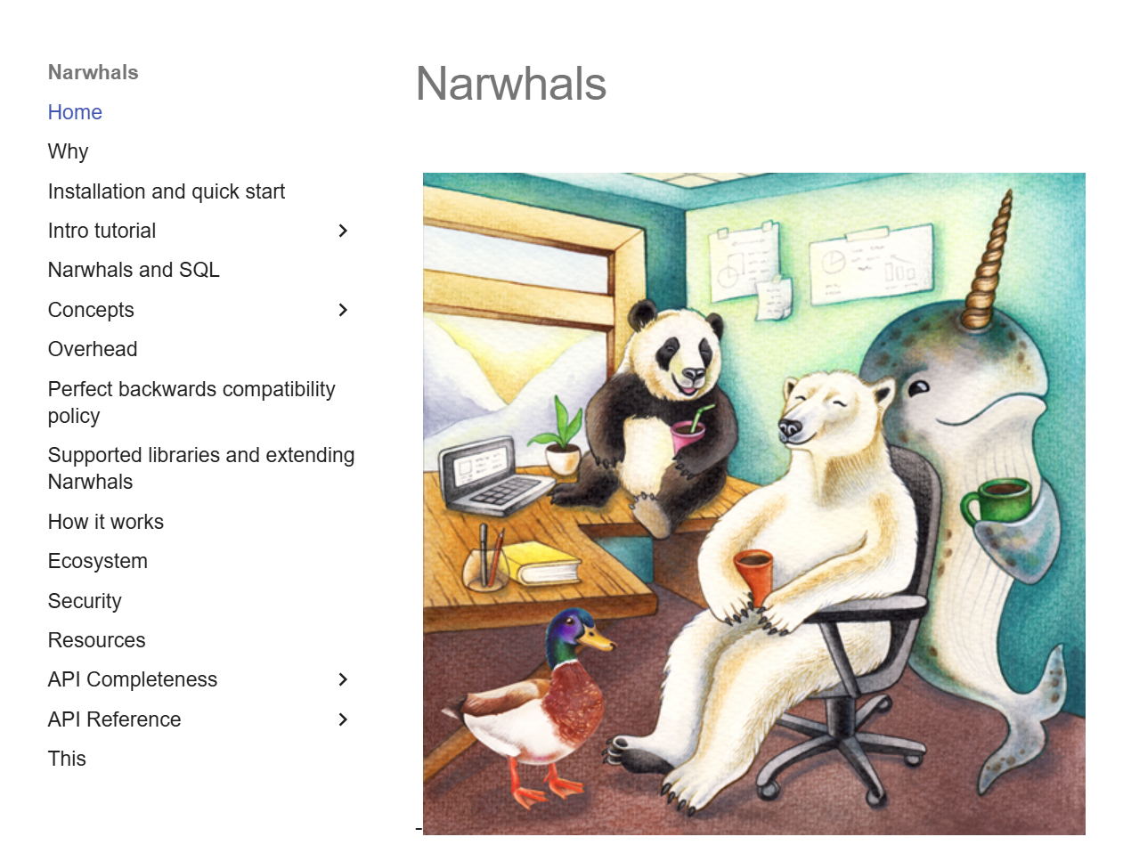

Slide 33
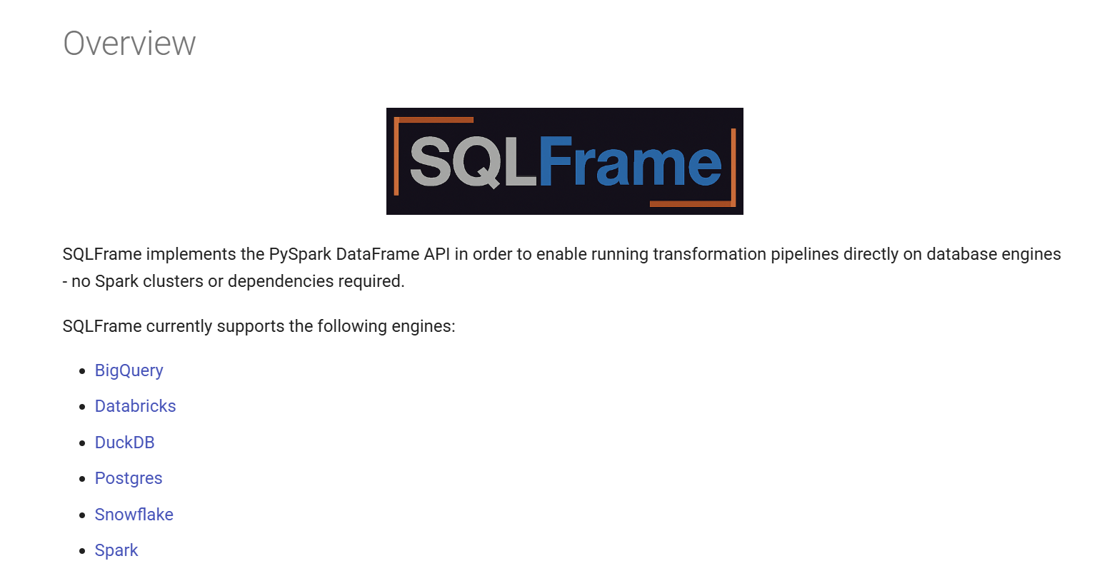

Slide 34
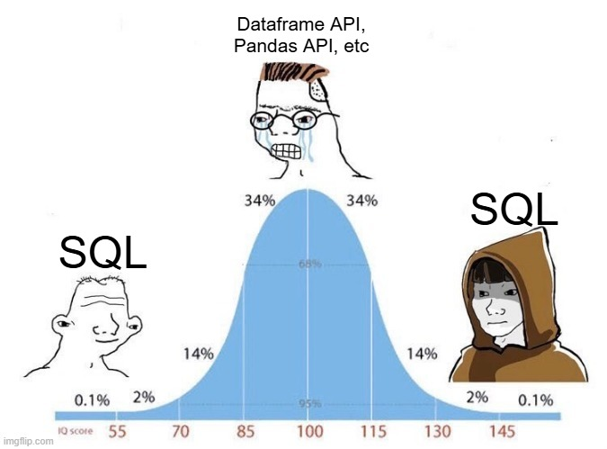

Slide 35
Real Life implementations

Slide 36
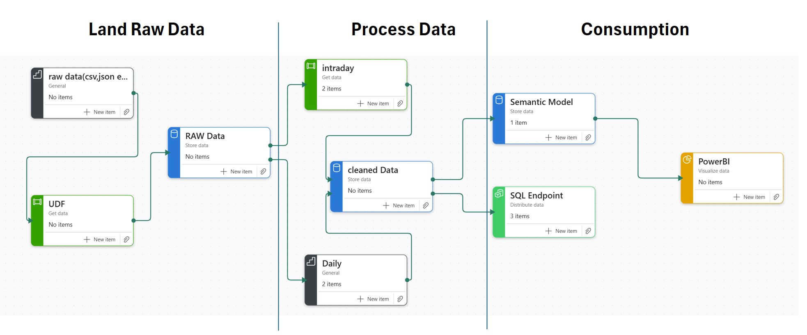
7 years' worth of data, 2600 files, 150 GB CSV uncompressed, untidy data
Data changed every 5 minutes

Slide 37
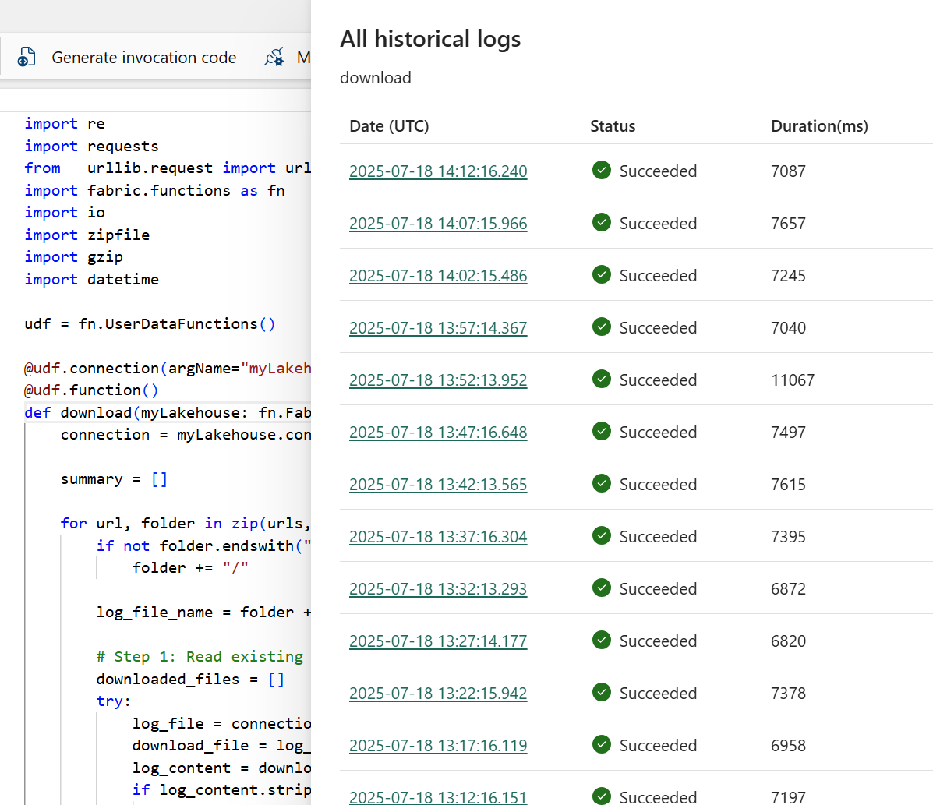

Slide 38
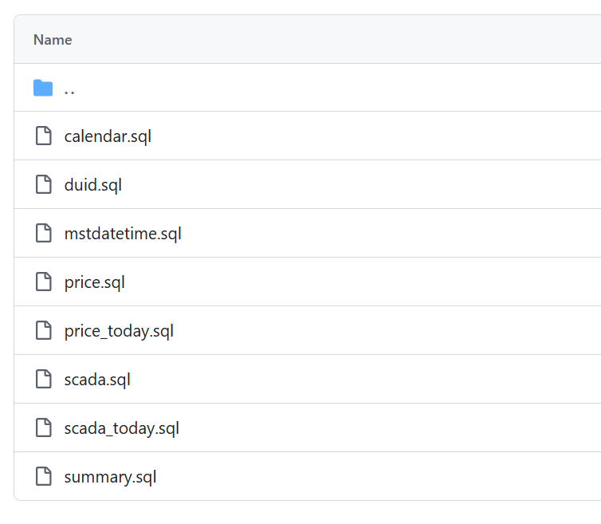

Slide 39

Thanks for listening

